Slide 1

Flow Sight
A Real-Time Data Engineering Pipeline for Traffic Analytics
Fundamentals of Data Engineering Project
Team 7
Members:
J. Nandini – 2420030262
S. Sai Saranya – 2420030266
B. Sai Charan – 2420030364
Faculty Guide
Dr. N. Sirisha
Associate Professor
01

Slide 2
Project Overview
01
Problem, Purpose & Objectives
02
Literature Survey
03
Research Gap & Proposed Solution
04
System Architecture
05
Data Generation, Validation & Transformation
06
Expected Output & Conclusion
02

Slide 3
Problem Statement & Project Purpose
Problem Statement
Project Purpose
Traffic sensors can generate continuous streams of vehicle-count and speed data. Raw events may contain missing values, duplicate readings or invalid measurements. Manual handling becomes difficult as the data grows, creating a need for an automated pipeline that can ingest, validate, transform and organize the stream.
FlowSight converts continuously generated traffic events into clean, structured and analytics-ready information. The processed data is used to identify peak traffic hours, frequently congested roads, average speeds, vehicle volume and data-quality issues.
Core idea: Build a reliable data pipeline — not a machine-learning traffic prediction system.
Generate → Stream → Validate → Transform → Store → Analyze → Visualize
03

Slide 4
Project Objectives
01
Generate traffic data
02
Stream the data in real time
03
Validate and clean raw traffic records.
04
Transform raw events into analytics-ready information.
05
Congested Road Identification
06
Real-Time Traffic Monitoring
04

Slide 5
Literature Survey
In the literature survey, we reviewed previous work in three connected areas: traffic and intelligent transportation data, real-time event streaming, and modern data-pipeline architectures. The review helped identify the need to handle continuously generated events through separate ingestion, processing, storage and analytics stages.
Traffic & Transport Data
Real-Time Event Streaming
Pipeline Architecture
Traffic systems generate continuous data from sensors, vehicles and monitoring sources. Research emphasizes the need for scalable collection and analysis of these high-volume data streams.
Streaming systems capture events from sources, move them continuously through the pipeline and support downstream processing. Kafka is widely used for this event-driven approach.
Modern architectures separate source generation, ingestion, processing, storage and analytics so each stage has a clear responsibility and can be improved independently.
Result of the survey: FlowSight combines these ideas into a manageable end-to-end learning project.
05

Slide 6
Literature Survey — Related Work
Study
Area
Key takeaway for FlowSight
Raptis & Passarella (2023)
A Survey on Networked Data Streaming With Apache Kafka
https://doaj.org/article/0bf1606df61b4c54a2efd970704b5c89?utm_source=chatgpt.com
Kafka / networked streaming
Shows Kafka's relevance across data, cyber-physical and streaming applications; supports using Kafka as the ingestion layer.
Kreps, Narkhede & Rao (2011)
Kafka: a Distributed Messaging System for Log Processing
https://kafka.apache.org/community/books_and_papers/?utm_source=chatgpt.com
Distributed event processing
Establishes Kafka as a publish/subscribe system for high-throughput event movement between producers and consumers.
Singh (2024)
Real-Time Data Processing ... Traffic Analysis
https://www.ijirmps.org/research-paper.php?id=230767&utm_source=chatgpt.com
Real-time processing / traffic
Highlights the value of real-time processing frameworks and low-latency analytics for traffic-related applications.
06

Slide 7
Research Gap & Proposed Solution
Existing Approaches
FlowSight Solution
Many systems are designed for large-scale production use, use multiple distributed tools, or focus strongly on traffic prediction and machine learning.
FlowSight provides a beginner-friendly but complete architecture:
Python traffic simulator
↓
Kafka event ingestion
↓
Validation & transformation
↓
PostgreSQL historical storage
↓
SQL analytics & Power BI visualization
Identified Gap
For learning Fundamentals of Data Engineering, students need a smaller project that still demonstrates the complete journey of continuously arriving data through a realistic pipeline.
Focus: demonstrate Data Engineering fundamentals clearly and practically.
07

Slide 8
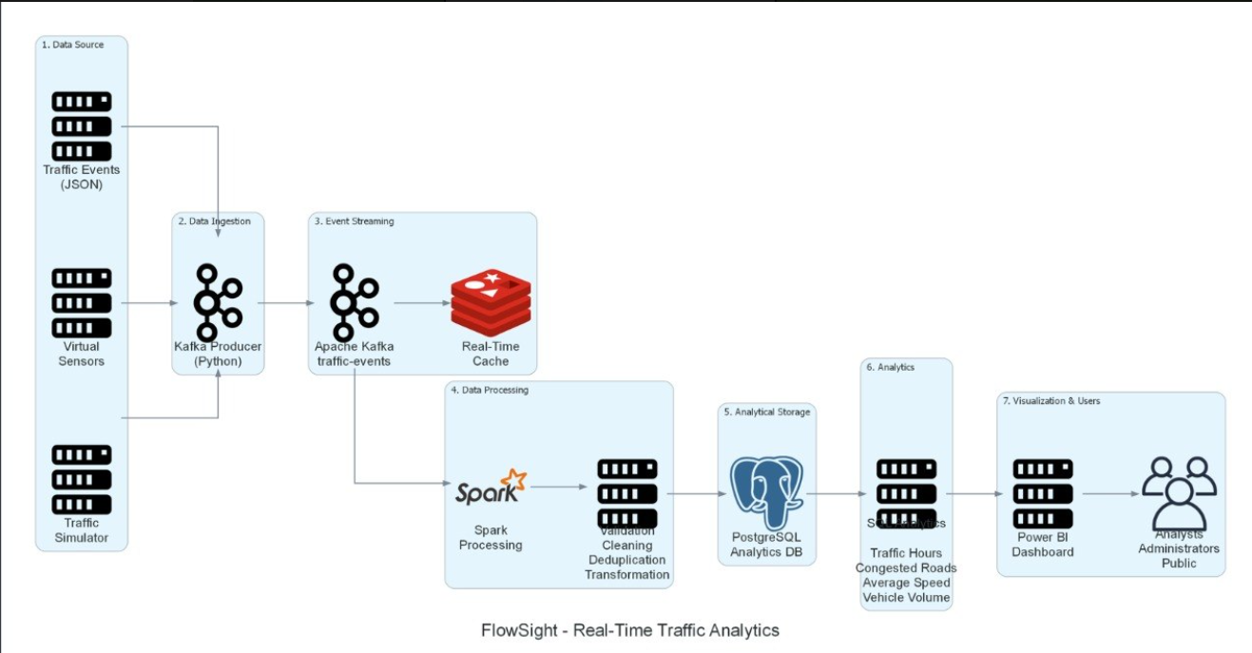
System Architecture:

Slide 9
Technology Selection
Python
Apache Kafka
Easy way to simulate continuously arriving traffic events and implement processing logic.
Acts as the event-streaming layer between the producer and consumer.
PostgreSQL
SQL
Stores clean structured records for historical queries and analysis.
Calculates averages, totals, peak periods and road-level traffic patterns.
Power BI
Presents processed information through dashboards and KPIs.
09

Slide 10
Data Generation
Source Simulation
{
"sensor_id": "S003",
"road_name": "Hitech City Road",
"timestamp": "2026-08-06 08:35:20",
"vehicle_count": 230,
"average_speed": 17
}
Python simulates multiple virtual traffic sensors and continuously creates events for different roads and times.
Why Simulated Data?
It allows the complete pipeline to be built and demonstrated without requiring physical traffic sensors or access to a live city traffic feed.
The event format is designed to be simple, structured and suitable for streaming as JSON.
10

Slide 11
Data Validation & Transformation
Raw Event
Validate
Reject / Error
Transform
Clean Record
Incoming JSON
Check quality rules
Keep invalid records for inspection
Standardize & derive fields
Ready for PostgreSQL
Validation Rules
Derived Fields
Example Rule
• sensor_id required
• timestamp required
• vehicle_count ≥ 0
• 0 ≤ speed ≤ 150
• duplicate events checked
hour, day, month, year, weekday, weekend_flag and congestion_level are calculated from the raw event.
If vehicle_count > 200 AND average_speed < 20 km/h, classify the event as HIGH congestion.
11

Slide 12
Expected System Output
Peak Traffic Hours
Congested Roads
Average Speed
Identify periods with the highest vehicle volume.
Find roads with high volume and low average speed.
Compare road performance over time.
Vehicle Volume
Historical Trends
Dashboard KPIs
Analyze total and average traffic counts.
Compare traffic conditions across dates and periods.
Present results clearly through Power BI.
Final output: clean data + historical storage + meaningful traffic insights.
12

Slide 13
Conclusion
Complete Pipeline
Practical Learning
Future Ready
Demonstrates the movement of data from source generation to ingestion, processing, storage and analytics.
Combines Python, Kafka, PostgreSQL, SQL and Power BI in one connected Data Engineering workflow.
The architecture can later be extended with PySpark, Airflow, larger datasets or additional data sources.
FlowSight transforms continuously generated traffic events into clean, structured and analytics-ready information.
It focuses on the Fundamentals of Data Engineering lifecycle rather than machine-learning prediction.
13

Slide 14
Thank You
14

